Slide 1

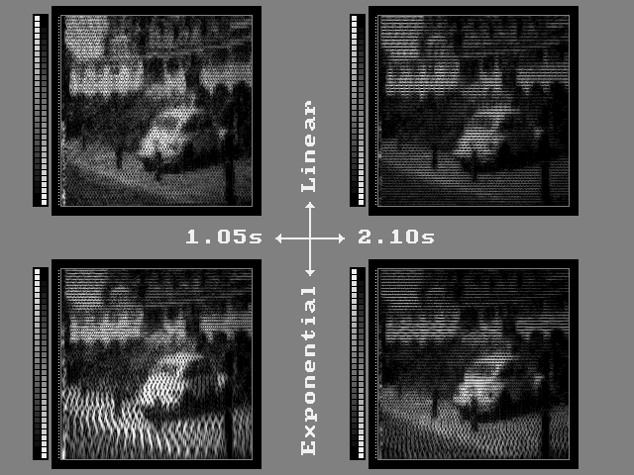
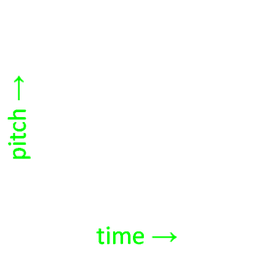

new directions in sensory substitution using visual-to-auditory sensory substitution* Peter B.L. Meijer
Durham, May 18 2023
*The vOICe spectrographic mapping
x → time & stereo panning
y → frequency (pitch)
brightness → loudness
www.seeingwithsound.com

Slide 2
overview
I’ll discuss
historical background: invasive & non-invasive approaches
lack of blind end-user training support and poor scalability
lack of studies on training (blind & sighted) humans, cf. AI
possible directions for research into training humans
conclusions, invitation to act, to create follow-up
this is an exploratory talk: incomplete, no final answers

Slide 3
historical background (incomplete for sake of time)
overall, there’s extremely slow progress in the visual prosthesis field
200x: 16 blind people received Dobelle brain implant in visual cortex, very little functional vision, project ended in 2004, no patient support
201x: ~350 blind people received Argus II retinal implant, very little functional vision, production stopped in 2019, no patient support
201x: development of Alpha AMS retinal implant, Retina Implant AG company dissolved in 2019 before entering the market, no patients
2018: blind user of The vOICe sensory substitution glasses beat 2 Argus II recipients at Neurothlon contest in Russia by a wide margin
2023: Pixium Vision receives FDA Breakthrough Device Designation for PRIMA retinal implant but current funds only last until July 2023 while market entry not expected before 2025; commercially viable?
2023: Vivani Medical “exploring strategic options” after taking over Orion I brain implant technology from Second Sight Medical Products
Notes:
(Second Sight Inc’s accumulated deficit rose to $304.8 million in 2019)

Slide 4
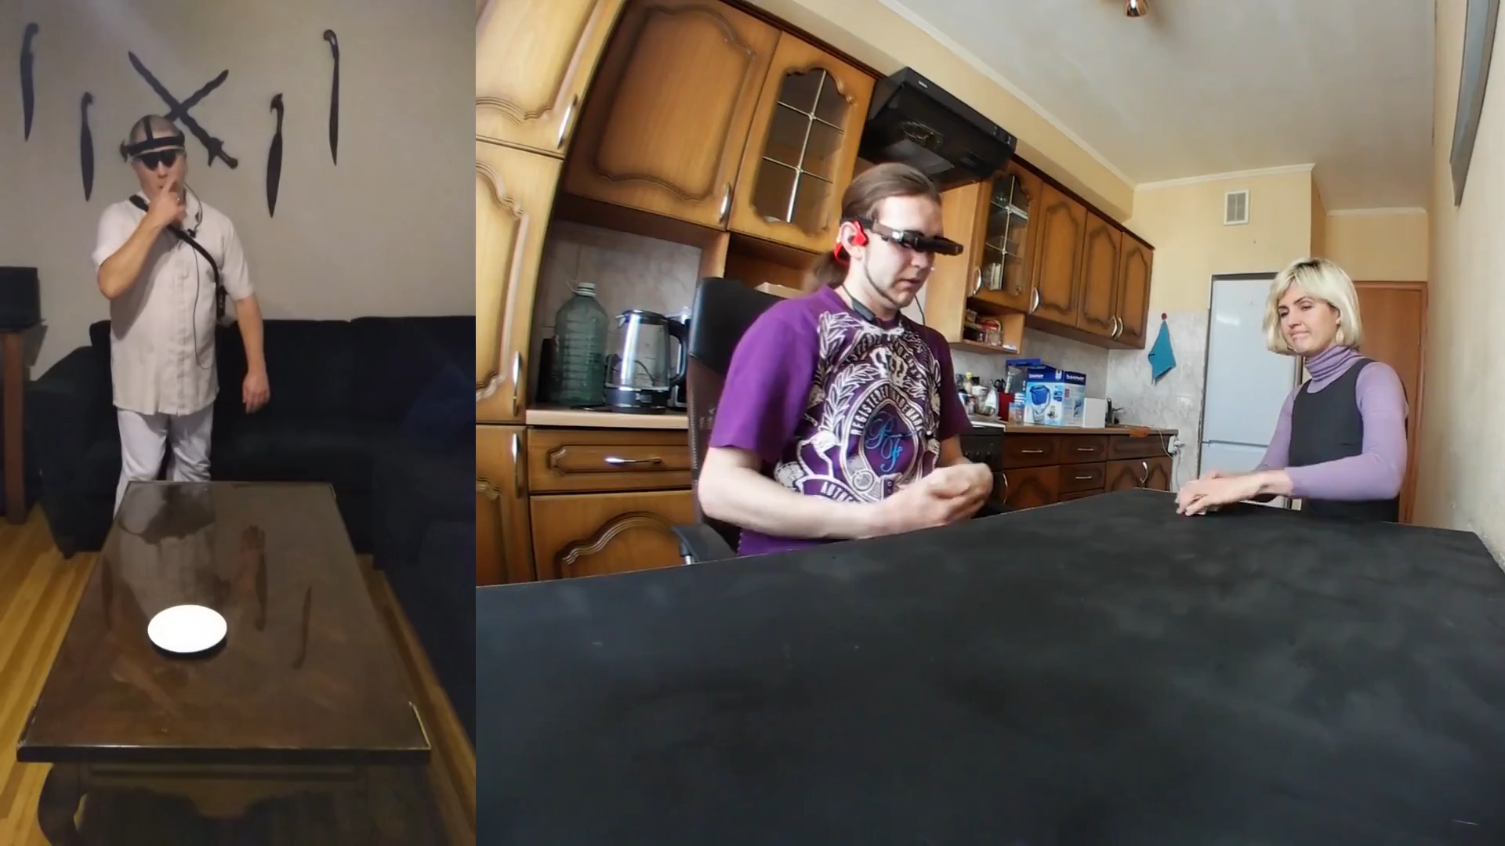
get an Orion I brain implant (Richard McDonald, left) or The vOICe vision glasses for the blind (Vadim Artsev, right)?
Orion I brain implant
The vOICe sensory substitution glasses
Notes:
Orion_I_brain_implant_or_The_vOICe_vision_glasses_Twitter.mp4

Slide 5
yet we are struggling!
claim: sensory substitution (notably The vOICe) can easily compete in functional vision with all contemporary retinal and brain implants
however,
smart glasses are less mature than smartphones, are expensive, have narrow FOV camera, mediocre low light performance, often lack key blind accessibility features for independent installation
mastering a novel sensory encoding is really very hard even for the best and brightest – how far can we get? how to get there?
in practice one needs 1-on-1 training support for good results, which does not scale, is expensive, and generally unavailable (Vadim Artsev got months of 1-on-1 training support)
in other respects, The vOICe easily scales to 40 million blind people (global software distribution, use of commodity hardware, ...)

Slide 6
how to proceed?
scientists want to understand stuff
run experiments under tightly controlled lab conditions
write papers under publish or perish conditions
results often barely relevant to daily living applications
engineers want to control stuff
implement things that work
try to find a market, start a company and make money
stereotyped, but can we better bridge science & engineering, R&D?
do you prefer to retire with a legacy of 1,000 published papers,
or with research results that changed the world for the better?
you can publish but you will perish anyway – we all do

Slide 7
yet we are struggling!
recruitment and training of blind people is hard to arrange, so initially
focus on sighted volunteers (read: students) to study learning-to-see
simplify things as needed make results attainable within typical time frames of academic studies
simplify things as needed to have well-defined and controlled lab conditions
do not over-simplify or your results likely become irrelevant to real-life applications

Slide 8
Albert Einstein supposedly said “everything should be made as simple as possible, but not simpler”
us:
“exercises for learning-to-see should be made as simple as possible, but not simpler”
but what does that mean?

Slide 9
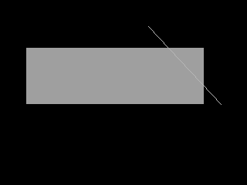
pictorial training data
minimally pictorial vision is an ill-defined concept, but think of
“non-trivial” as in having more than 1 (type of) shape/object, beyond single object tracking, each shape/object with its own (non-trivial subset of) { pattern, position, orientation, aspect ratio, size }
synthetic images via random generation from parameterized shapes
infinite data set: you can always generate still more test data after training to avoid meta-optimization pitfalls (testing and tweaking different methods and picking the one that performed best in validation, but then you need to test again to see if the selected method remains consistently best)

Slide 10

soundscape of a random rectangle & line repeats 4 times
you try to visualize the soundscape
source image of soundscape appears with 4th soundscape
you learn from your mistakes (mental imagery vs source image)
wash, rinse, repeat
generated by The vOICe for Windows’ Exercise mode
https://www.youtube.com/watch?v=ihSbdGjB3BQ
Notes:
Screen Recording (09-07-2022 15-32-48)_YouTube_ihSbdGjB3BQ_start.mp4

Slide 11
adjust focus
now this video material is aimed in part at evoking visual qualia in due course, while qualia are about as ill-defined as consciousness
moreover, this video material is aimed at sighted self-training, so tweaking is needed to turn it into material for scientific studies by making things measurable
after some training, present and repeat a soundscape while asking which of a small set of images most closely resembles the soundscape’s visual content (as visualized/understood by the subject): multiple choice
those test images can be generated from the same image generator used for generating training data through (optionally constrained) random variations on the (random) parameters used to generate the source image of the soundscape

Slide 12
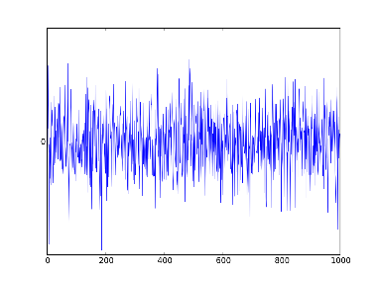
multiple choice
A
which image matches the soundscape? A, B, C or D
source image
(not shown)
B
soundscape
C
source image is parameterized {rectangle, line},
with parameter vector p that is randomly drawn
multiple choice images have parameters p + δ
with changes δ also randomly drawn, in smaller range with and optional other constrains (e.g., varying only the elevation of one shape)
D

Slide 13
concept plot of learning progress (fake data)
100%
subject 1
subject 2
subject 3
performance (% correct)
saturation far below 100% ?
different subject strategies?
increases in automaticity?
fMRI activity changes?
...
chance level
25%
0
7
14
21
28
# training days

Slide 14
other directions for research
in normal vision, enclosure is easily perceived
not so in soundscapes (spectrotemporal mapping)
in normal vision, kinks (high curvature points) are easily perceived
not so in soundscapes
can “visual” feature detectors arise from or get recruited by training?
❌
✅
❌
✅

Slide 15
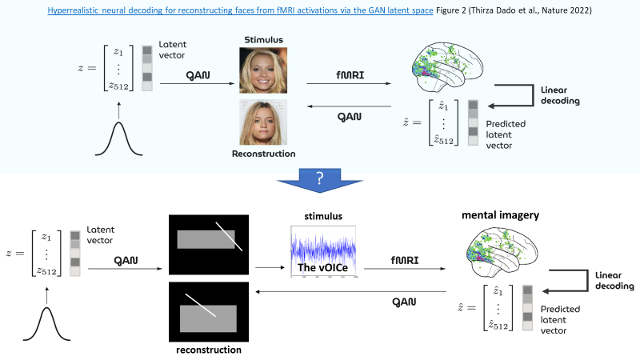
other directions for research
extracting mental imagery from brain scans
at some point in the future, it may even be possible to “measure” soundscape visualization skills of sighted and blind people using fMRI or other neuroscience tools by decoding brain activity into images from a finite or infinite set of images (image reconstruction), by extension of what is currently done with AI models and regular visual inputs instead of visualized soundscapes (mental imagery)

Slide 16
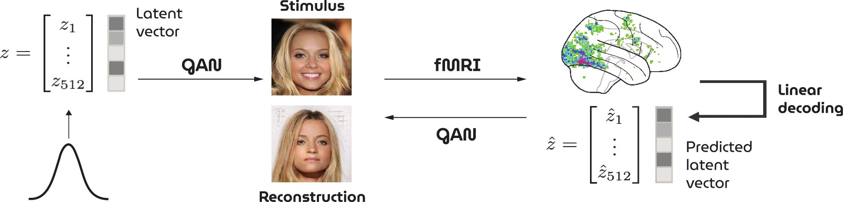
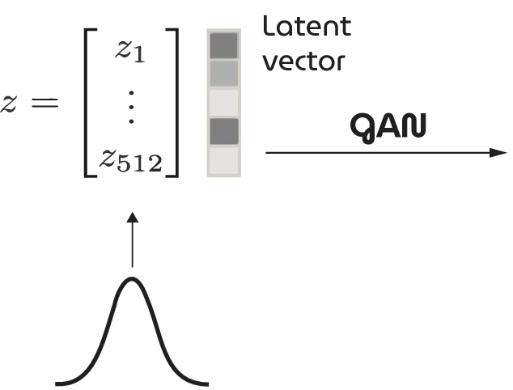
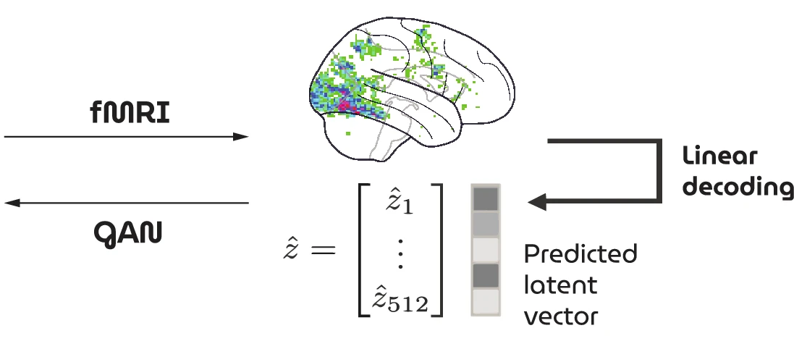
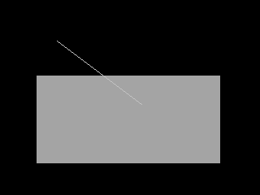
Hyperrealistic neural decoding for reconstructing faces from fMRI activations via the GAN latent space Figure 2 (Thirza Dado et al., Nature 2022)
?
stimulus
mental imagery
The vOICe
reconstruction

Slide 17
conclusions
recruitment of blind people for studies is hard, time-consuming
start with sighted volunteers (students, ...)
mastering daily living vision skills is very hard, time-consuming
start with easier “minimally-pictorial” training data
objectively scoring performance as a function of limited time
multiple choice makes differences with correct answer quantifiable
does performance saturate at some point in time?
which training method works best?
neural plasticity: find brain changes before/after training (fMRI, ...)
do better performers show bigger brain activity changes?
do brain activity changes saturate at some point in time?
decode mental imagery as a metric for vision from sensory substitution?
on qualia: does training result in forms of acquired synesthesia? does the experience become vision-like?
...

Slide 18
https://www.seeingwithsound.com/extra/Durham2023.pptx

